Slide 1
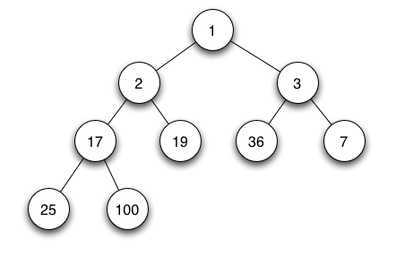
Heaps
https://upload.wikimedia.org/wikipedia/commons/6/69/Min-heap.png

Slide 2
Full Binary Trees
a full binary tree (aka proper binary tree or 2-tree) is a binary tree in which
every node has 0 or 2 children.
i.e. every node except leaves have 2 children

Slide 3
Complete Binary Tree
a complete binary tree is a binary tree
filled at all levels except possibly at the lowest level, and all the nodes at the lowest level are as far to the left as possible
a complete binary tree may not be full
a full binary tree may not be complete

Slide 4
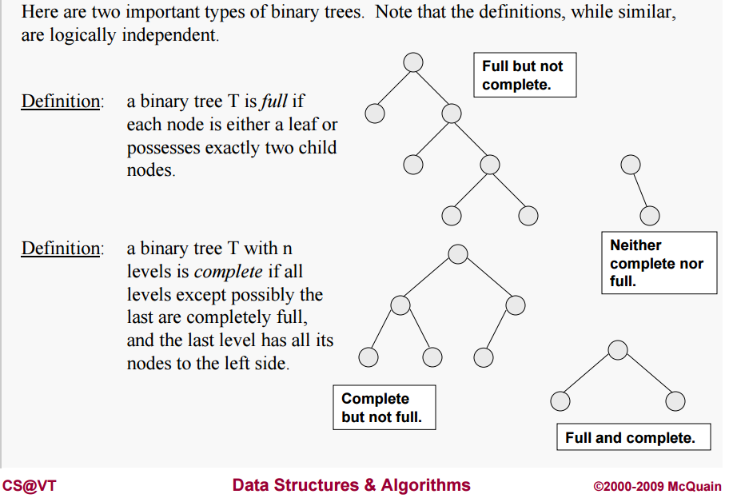
Full vs Complete
http://courses.cs.vt.edu/~cs3114/Fall09/wmcquain/Notes/T03a.BinaryTreeTheorems.pdf

Slide 5
Perfect Binary Trees
a perfect binary tree is a full binary tree with all of its leaves on the same level
a perfect binary tree is full and complete

Slide 6
Example: Complete Binary Tree
All nodes on the last level are all the way to the left

Slide 7
Complete Vs. Search Trees
note that a complete binary tree is not necessarily a binary search tree
there are no restrictions on the contents of a node in a complete binary tree
nodes in a complete binary tree need not contain comparable values

Slide 8
Another Example
the following tree is a complete binary tree, but not a binary search tree

Slide 9
Definition of Min Heap
a min heap is a complete binary tree with 2 additional properties:
the contents of each node must be comparable
the value of each node must be <= the value of each descendent

Slide 10
Recursive Def of Min Heap
a heap is a complete binary tree that is either empty or:
the root element is the smallest element in the tree, according to some method for comparing elements
and the left and right subtrees are heaps

Slide 11
Example of a Min Heap

Slide 12
Top of the Heap
the root of the tree representing a heap is called the top of the heap
the top of a min heap always contains the smallest element in the heap
top

Slide 13
Last Element in the Heap
the last element in a heap is the element in the rightmost position of the lowest level
last

Slide 14
Adding an Element to a Heap
to add an element to a heap
if the last level is not full, the element is added in the next available position on the last level
if the last level is full, the element is added to the leftmost position of the next level
after adding the object to the heap, the object is moved up the heap if necessary to restore the heap properties

Slide 15
Example: Adding an Element
add 14 to the following min heap

Slide 16
Example: Adding an Element
begin by adding 14 to the lowest level of the heap

Slide 17
Example: Adding an Element
restore the heap property by swapping 14 with its parent repeatedly, as long as the contents of the parent node > 14
only one swap is required in this case

Slide 18
Removing an Element
the only element you can remove from a heap is the top element
to remove an element from the heap
the last element is moved to the top
the heap property is then restored by moving the top element down the tree and into the correct location

Slide 19
Removing an Element
Compare left and right child to determine whether to move top down left or down right
pick the subtree with the smallest root
if the two roots are equal, choose either

Slide 20
Removing an Element
before moving top element down, we compare to the child node on the subtree that we are moving down
if the child node is smaller than the top element, then we swap the two nodes
when a swap is no longer necessary, we are done

Slide 21
Example: Removing an Element
remove the top element from this heap

Slide 22
Example: Removing an Element
replace top element with last element
Now, the left subchild is smaller (5)

Slide 23
Example: Removing an Element
so we go left and swap 5 and 22
Now, the right subchild (of 22) is smaller (6)

Slide 24
Example: Removing an Element
in the previous slide, the right subchild of 22 is the smallest, so we swap 22 and 6, and we are done

Slide 25
Implementation of Heaps
heaps may be implemented using either binary trees or arrays
to represent a heap as an array, the nodes are mapped sequentially to the array, traversing the tree from top to bottom, and at each level, from left to right

Slide 26
Array Implementation:Addressing
for easier addressing, the root may be placed at index 1 in the array
if the root is at index 1, the children of the node in location n are at:
2*n
2*n + 1

Slide 27
Array Implementation-Example
here is the array representation of the heap shown below
0 | 1 | 2 | 3 | 4 | 5 | 6 | 7
 | 2 | 5 | 14 | 10 | 6 | 22 | 18
2*(1) = 2
2*(1) + 1 = 3

Slide 28
Definitions
Binary Tree (node-based)
Full/Proper/2-Tree (node-based, 0 or 2 children)
Complete (level-based, no wasted space)
Perfect (full & complete)
Binary Search Tree (BST)
Balanced BST
Heap (min-Heap, max-Heap)

Slide 29
Heaps
The End
https://upload.wikimedia.org/wikipedia/commons/6/69/Min-heap.png

